Slide 1
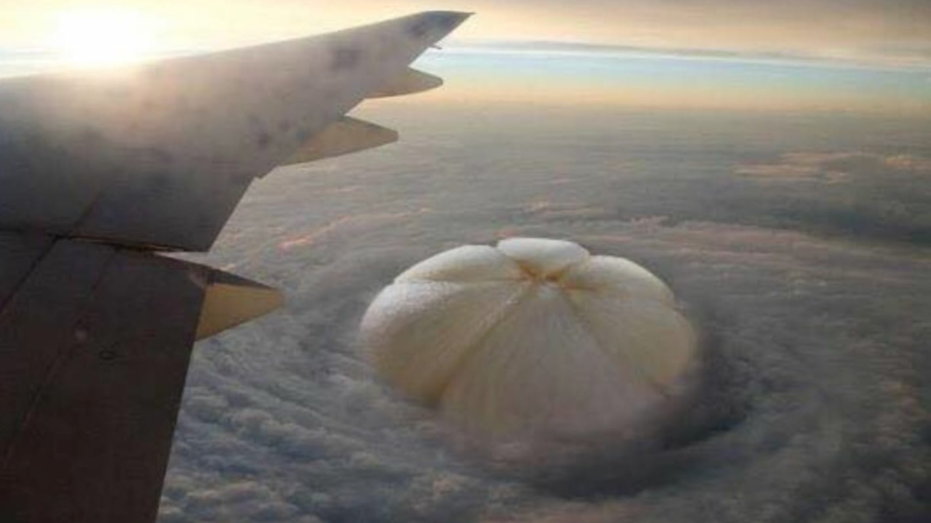

Slide 2


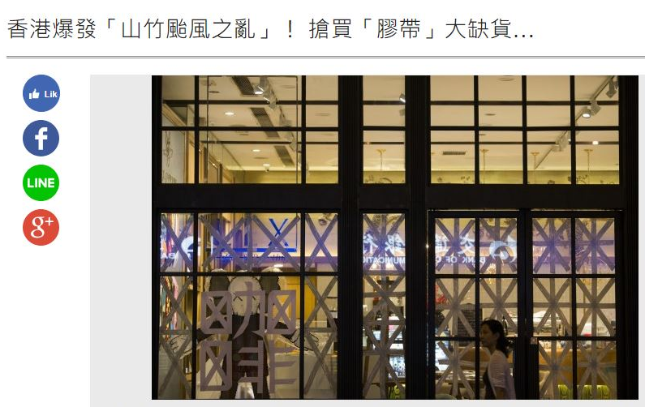

Slide 3

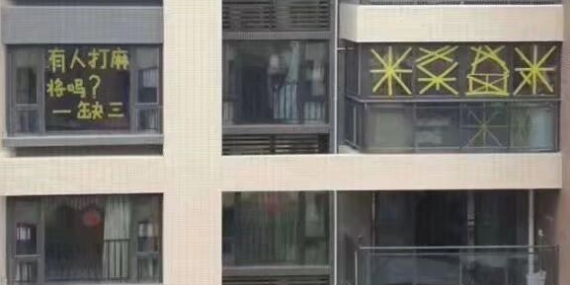

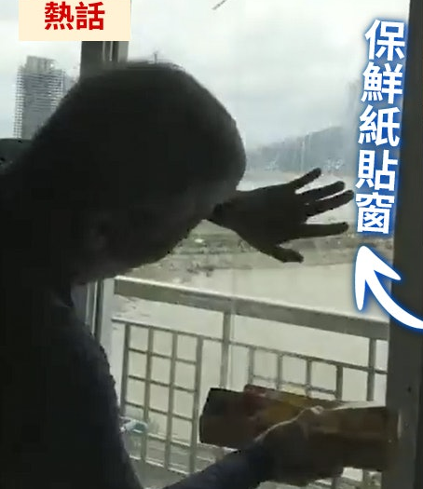

Slide 4
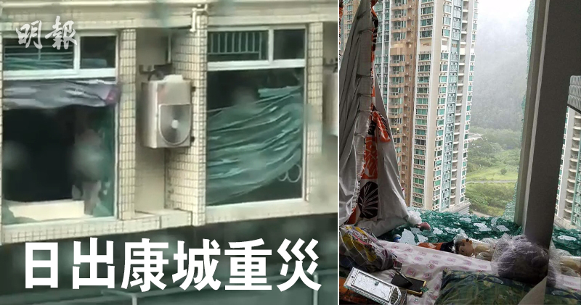
If they had known...

Slide 5

The Traditional 45 Year Plan
95% of the population spend 45 years of their lives helping the other 5% to become successful.
They work diligently to make other people rich, while earning a meager salary themselves!
5%
95%
Financially sound
Financially strapped

Slide 6

Ongoing income
Financial independence, time freedom
What is your choice?

Slide 7

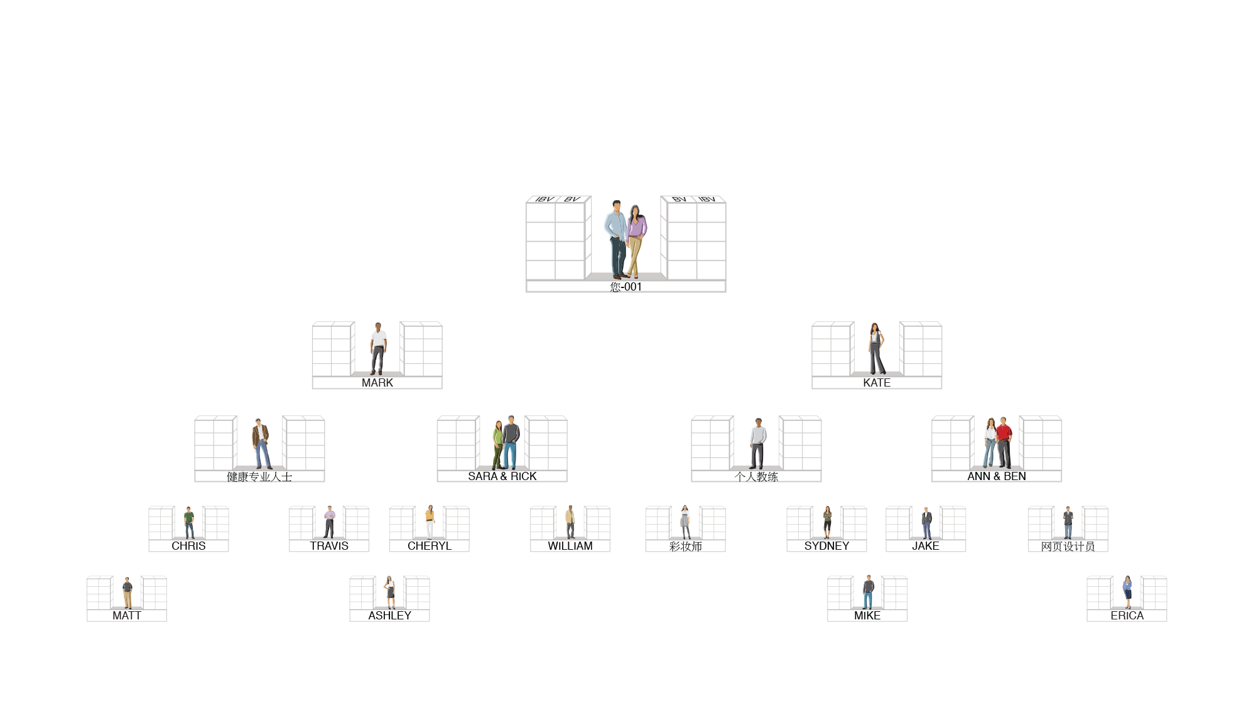

MA Tracking System Searches Daily to Infinity
The system tracks purchases and sales made by you, your customers and your team. You receive 100% credit for all volume generated within your organisation.

Slide 8






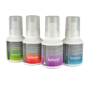




A Team that Correctly Implements the Shopping Annuity
BV & IBV
BV & IBV

Slide 9
Linear Income
Ongoing Income
Principal Income
Interest Income
Trade time for money
Effectively control your own time
Income increases linearly
Income increases exponentially
Work stops, income stops
Earn ongoing income
Unable to accumulating wealth
Can accumulating wealth
Time is not your own
Total time freedom
Only make a living
Create your desired lifestyle

Slide 10
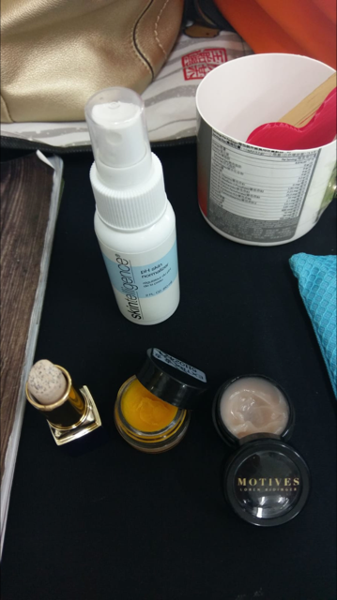
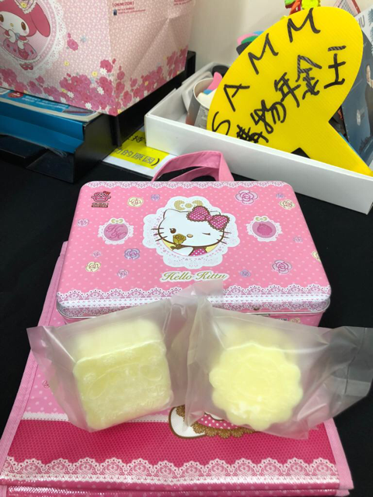
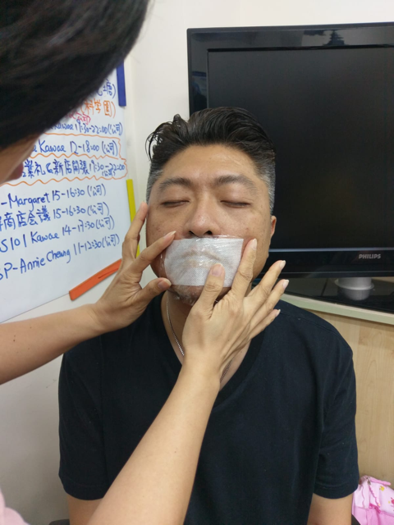
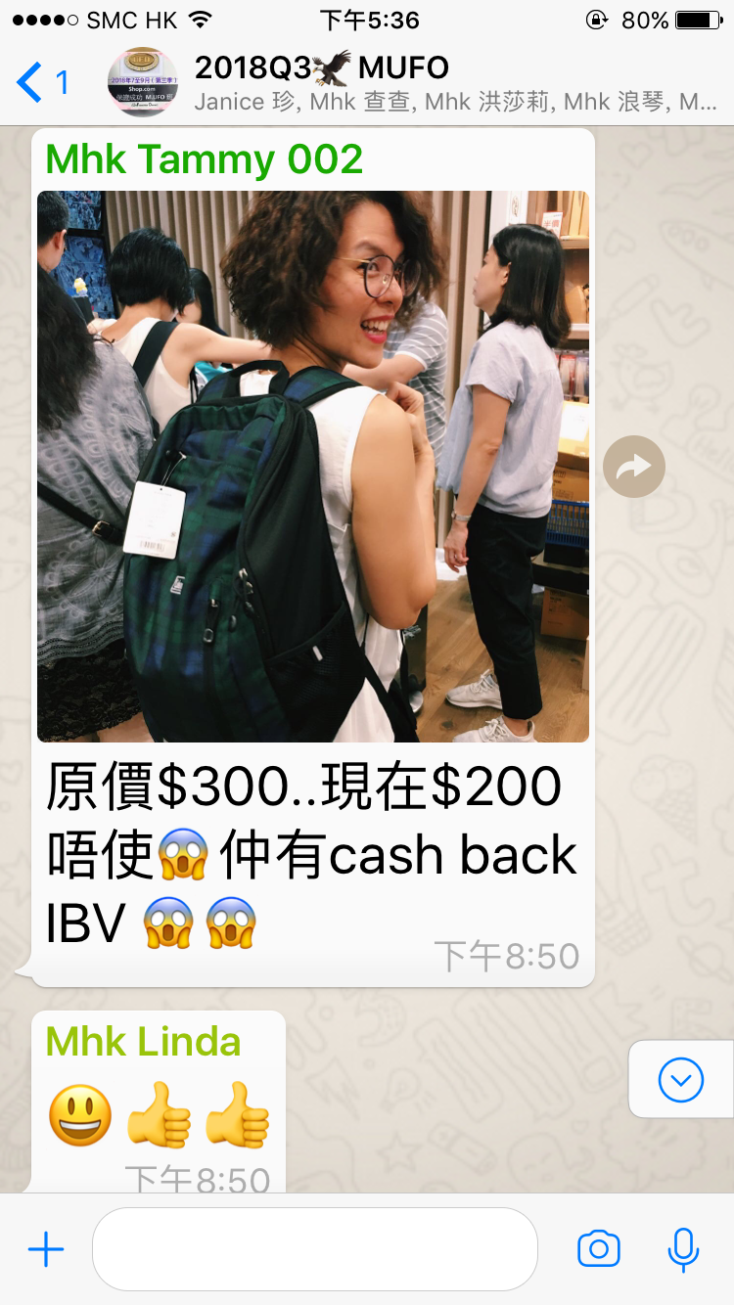
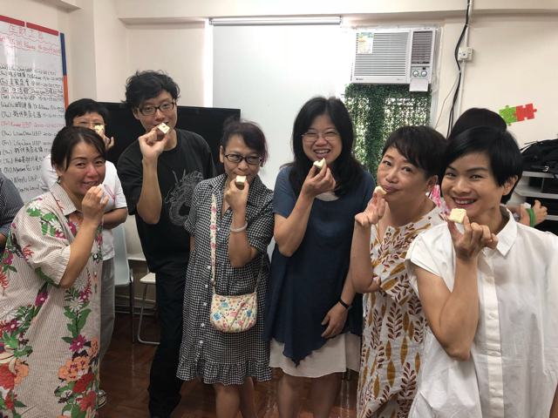
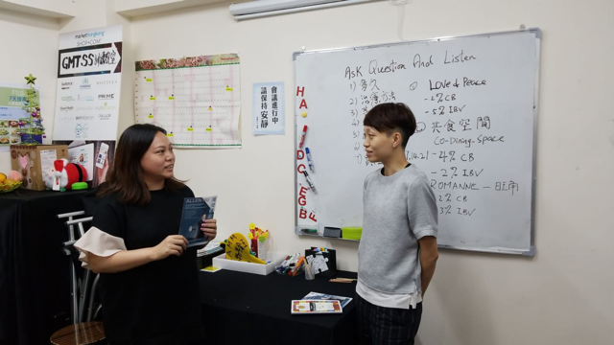

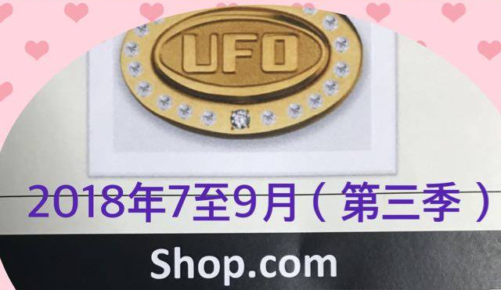
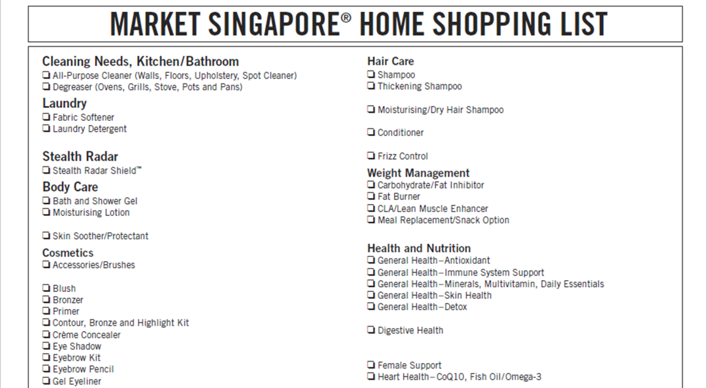

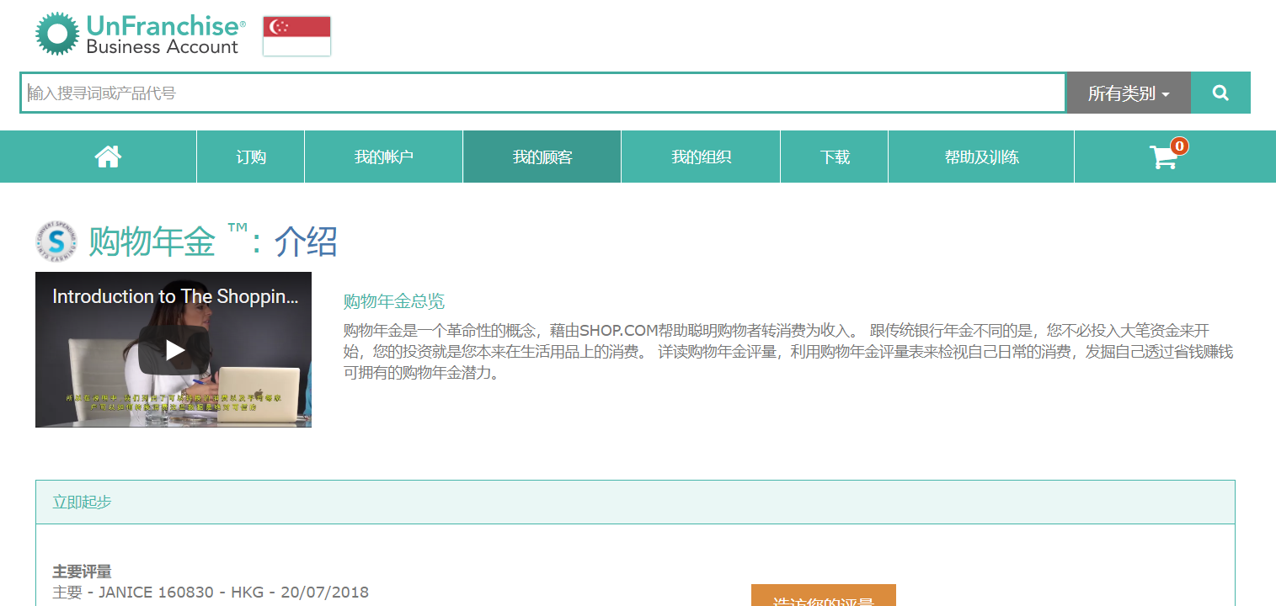
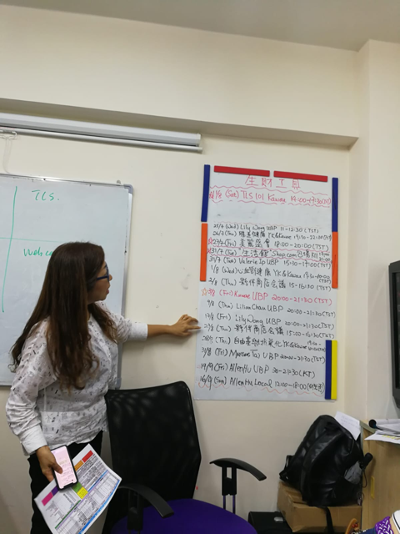

A Team that Correctly Implements the Shopping Annuity
Redirecting Daily Purchases for
Personal Use
  Exclusive products
    Use Home Shopping List
    Complete the Shopping
    Annuity Assessment
    Share testimonials, experiences and
    stories among partners
    Attend product training and workshops
  Partner Stores
    Social media group information and sharing
    Sharing at regular team meetings
  GMTSS
    IBV vs Cashback / saving

Slide 11

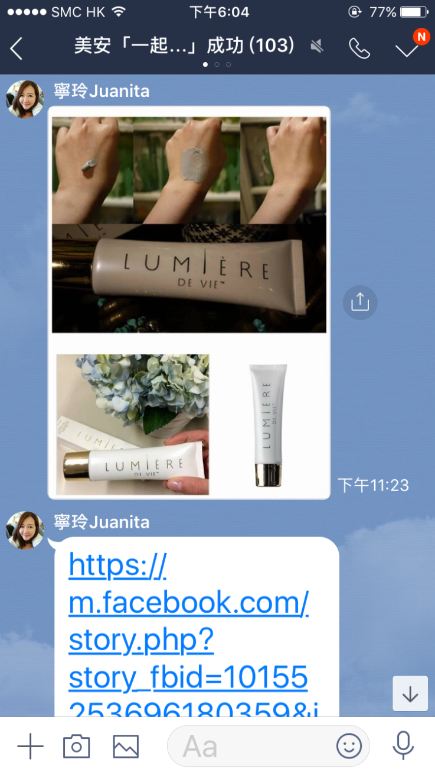
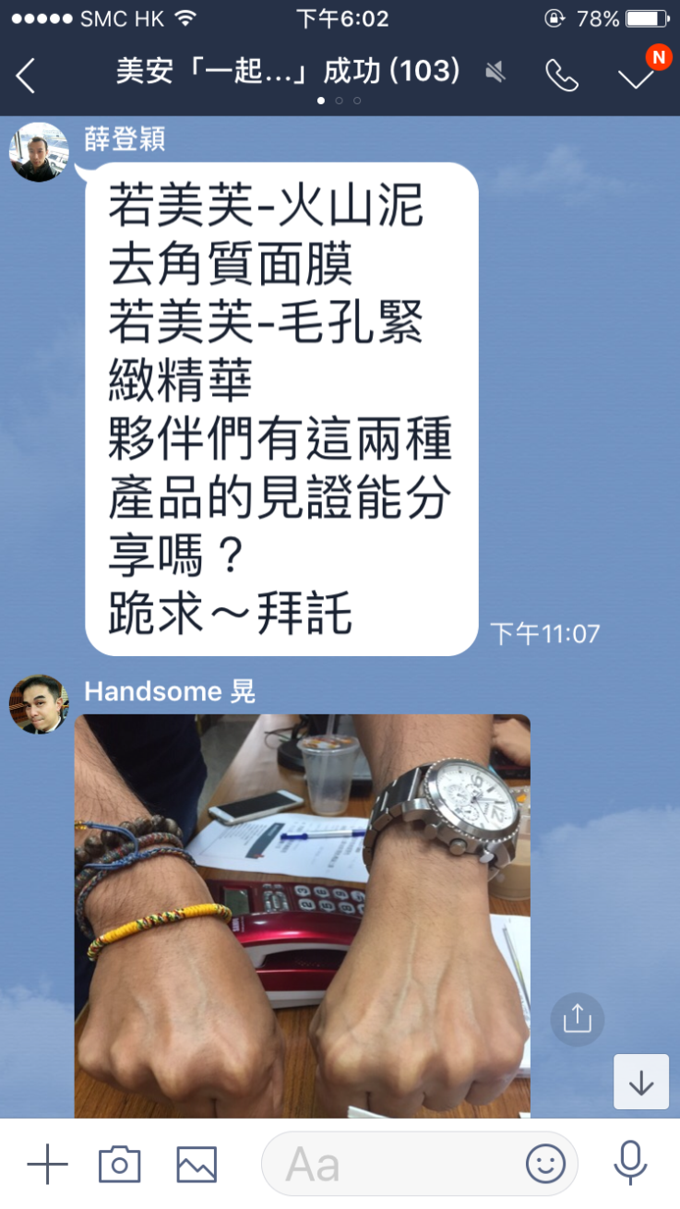
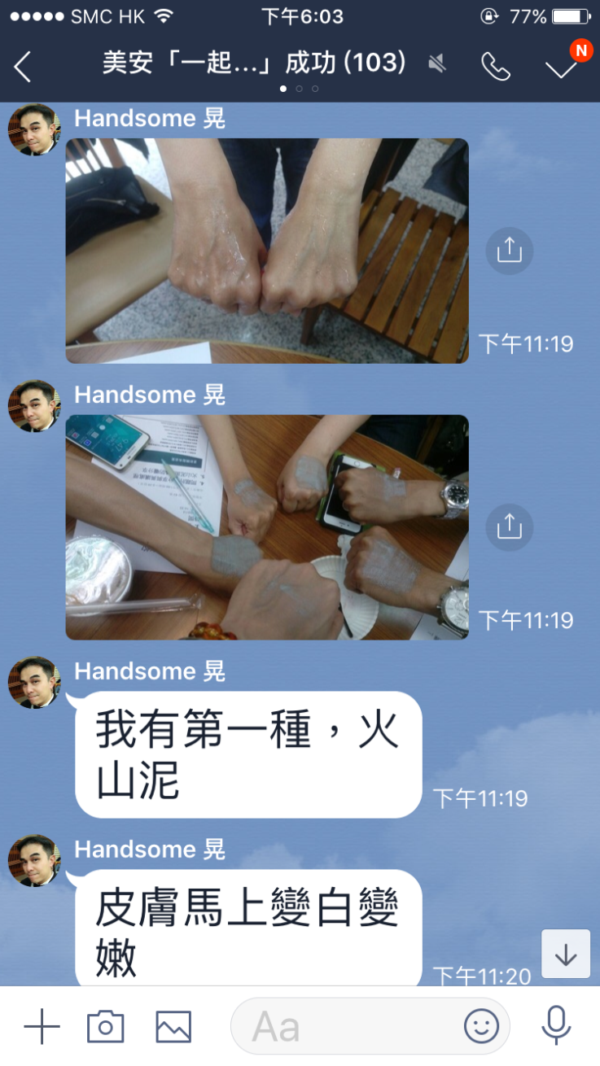
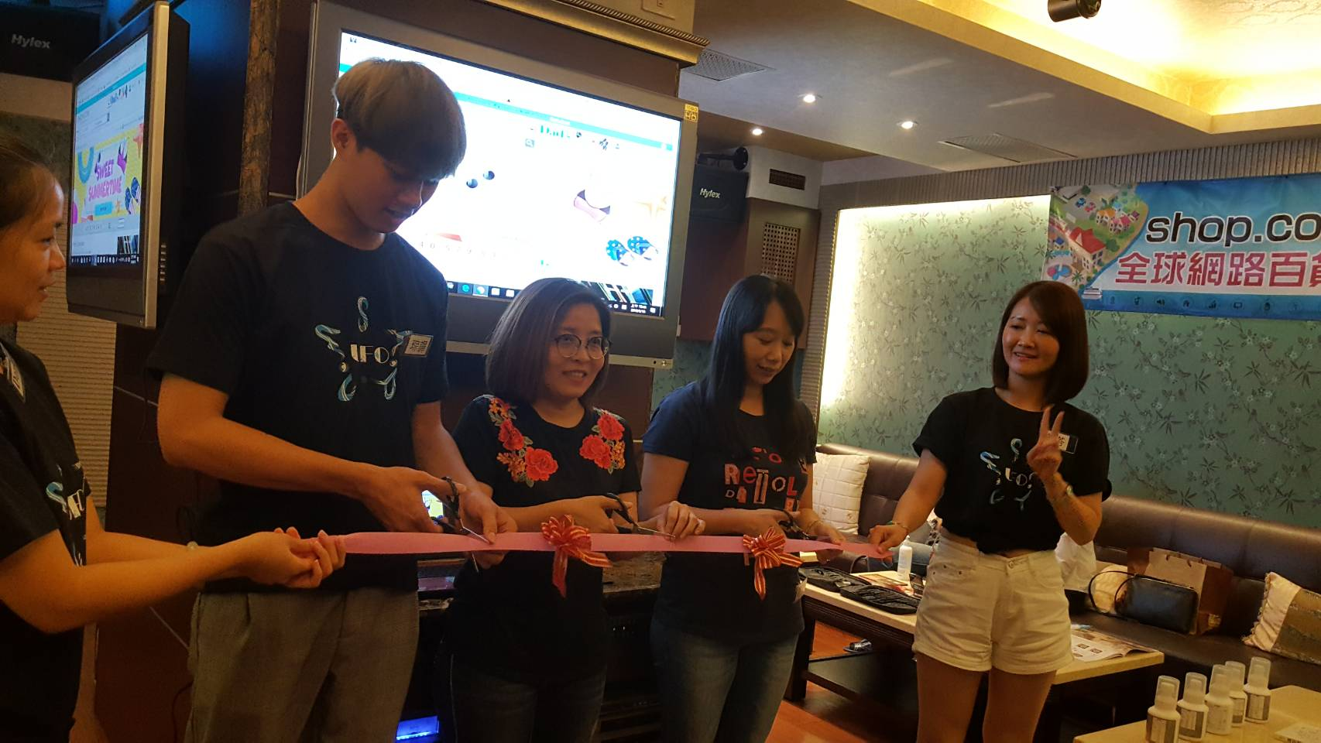
A Team that Correctly Implements the Shopping Annuity
Develop a retail base
  Partner’s Personal Sharing
    Focus on genuine care
    Leverage testimonials
    Depend on team support
  Team Events
    TLS Overview, 21Days,12Weeks
    IBV party, Wellness Event
    New store opening
  GMTSS
    Product training
    Workshops
  Partner Stores Sharing

Slide 12
A Team that Correctly Implements the Shopping Annuity
Prospecting and Recruiting
  1a Through Retailing Name List
    Follow up on stable repeat customers
    Expand their use of products
    Share business opportunity to convert spending into earning
  1b Through Trusted Name List
    Directly share business opportunity to convert spending into earning
    Invite them to review products
  1c Through Other Name List
    Communicate to built consensus and recognition
    Share business opportunity to convert spending into earning
  UBP, Product Training and B5
  Senior Partners to Assist – Handle Objections and Referral

Slide 13
Make name list and build relationship
UBP
Product training
B5
ABC
Objection handling
Referral and
Getting Started Guide
2 minute
Introduction
Share products and the business
Evaluation Procedure

Slide 14
A Team that Correctly Implements the Shopping Annuity
ABC Pattern
  Follow up on New UFO
    Use the Getting Started Guide
    Redirect purchases – use products and set AutoShip
    Attend regular meetings and introduce them to GMTSS
  Follow up on UFMS
    New Distributor Qualification Report, website setup, Form 1000 and more
    Team Purge Warning Report, Calendar setup, SAMM and more
  And also...

Slide 15
A Team that Correctly Implements the Shopping Annuity
ABC Pattern of Duplication
  Product Support
    Offer the stage and give praise
    Provide backend support
  Support for Recruiting
    Use system tools
    Pre-convention preparation and post-convention review
    Give acknowledgement and encouragement
  Create Duplication Mindset
    Take the opportunity to teach
    Guide their way of thinking

Slide 16
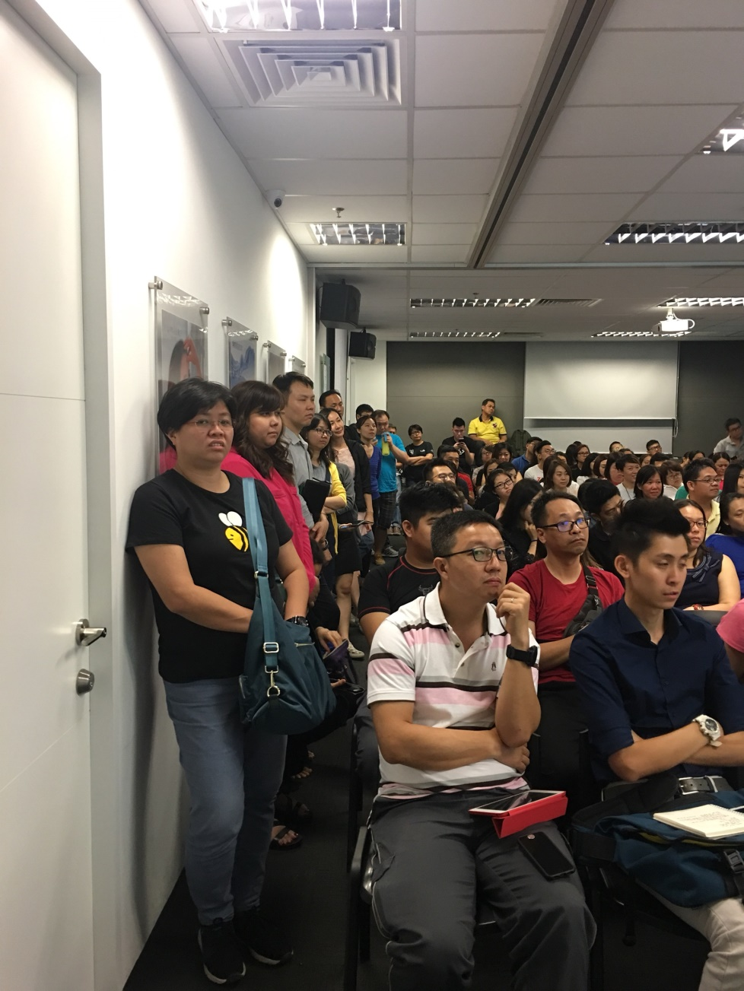
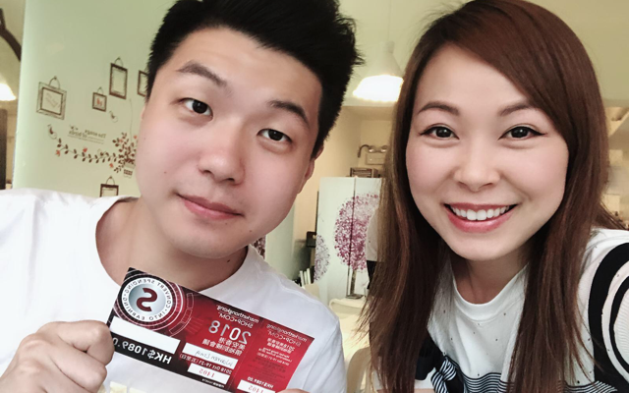
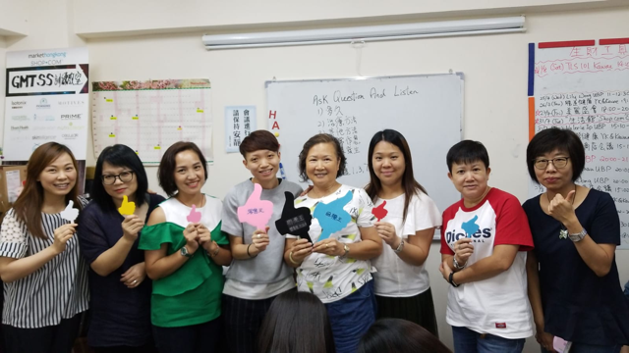
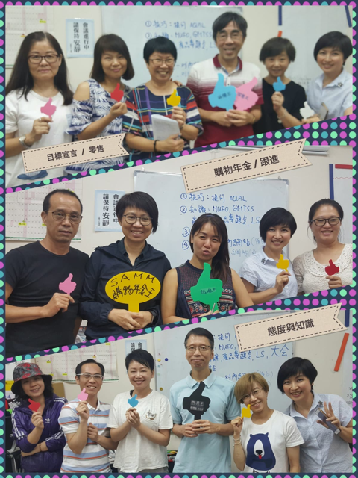
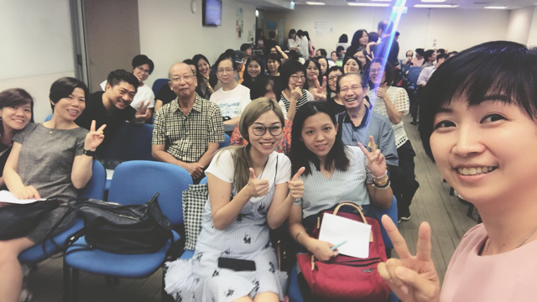
A Team that and Correctly Implements the Shopping Annuity
Automatically

Slide 17
How to Work with Team Leaders
Know each other’s dreams
Guiding leaders with genuine concern
Offer help when others are in need

Slide 18



Slide 19


Slide 20
How to Work with Team Leaders
Know each other’s dreams
Guiding leaders with genuine concern
Offer help when others are in need
Lead the leader to understand the value of SHOP.COM

Slide 21
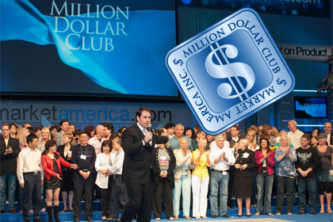
Witness the Future!!

Slide 22

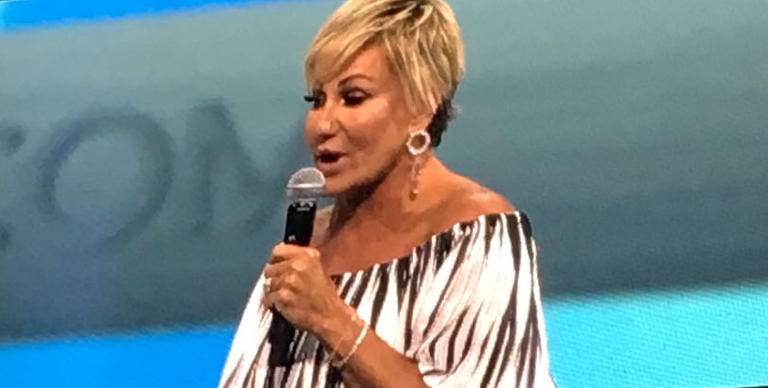

Tony & Pam

Slide 23
Companies How
The Power of Joined Forces
Your How
Your What
Your Golden Circle
MA’s Golden Circle
Your Why

